Slide 1
Weather Analysis
Weather analysis is a multidimensional field that blends data science, modeling, and scientific research to provide valuable insights into the dynamic behavior of the Earth's atmosphere. Its applications span multiple industries and contribute to informed decision-making, safety, and the well-being of society.

Slide 2
Introduction
The purpose of this analysis is to provide a comprehensive overview of the weather conditions in over the specified date range. By examining various meteorological parameters such as temperature, precipitation, wind patterns, atmospheric pressure, and humidity, we aim to gain insights into the past weather trends, identify anomalies, and offer valuable information for various stakeholders, including agriculture, transportation, or emergency services. Through this analysis, we hope to contribute to a better understanding of the local climate and its implications

Slide 3
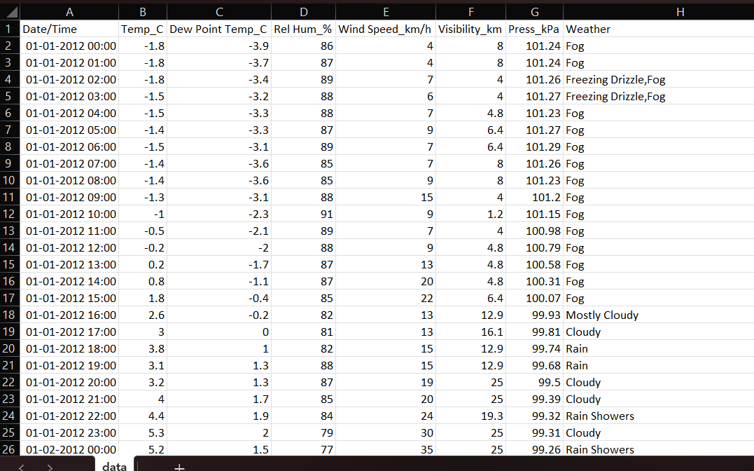
Data Sources
We obtained data set from online source.
The data set contain :Date & Time, Temp, Dew Point, Relative Humidity,
wind speed, etc.

Slide 4
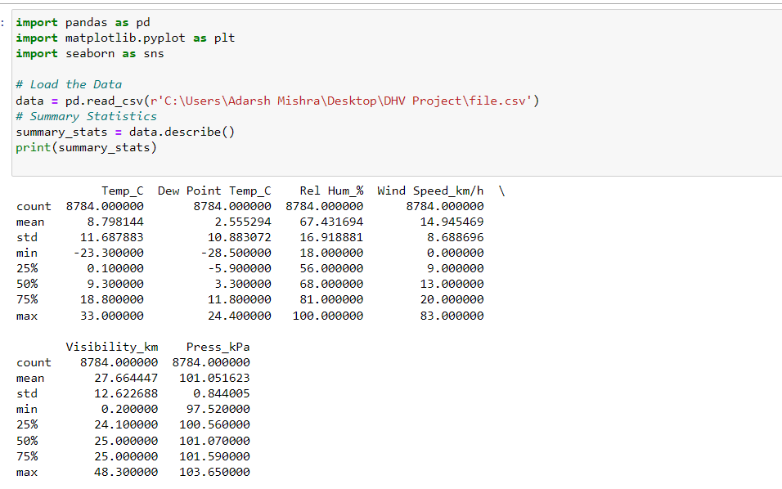
Data Exploration and Initial Analysis
Summary statistics-

Slide 5
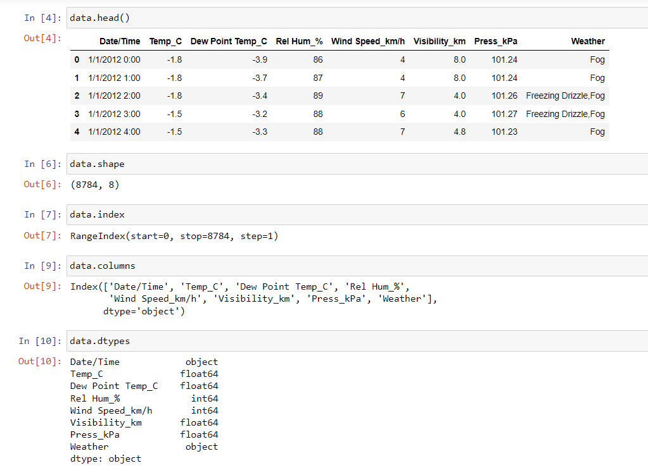
Data types and structure-

Slide 6
Data cleaning
Data cleaning is a systematic process that involves identifying and correcting errors, inconsistencies, and inaccuracies in a dataset to improve its quality and reliability
Data cleaning is important for several reasons, as it plays a crucial role in ensuring the accuracy, reliability, and usability of data in various applications and industries.
In our data set column were not aligned we used auto fit column width tool.

Slide 7
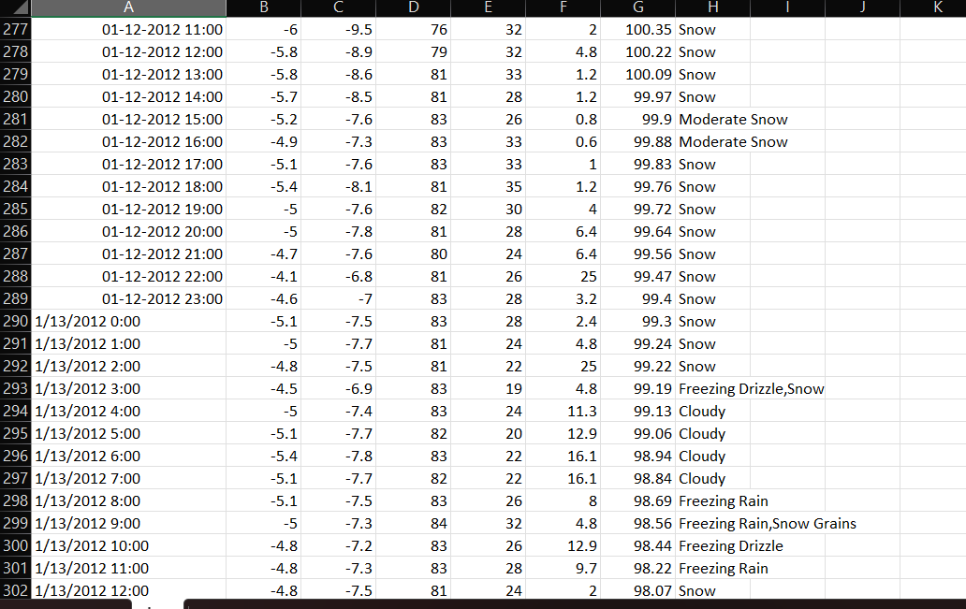
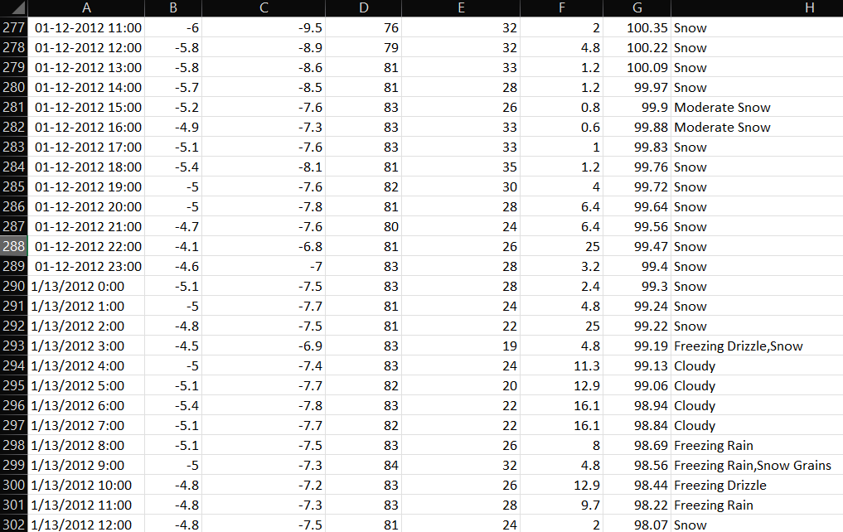

Slide 8
Data analysis
Data analysis is the process of inspecting, and interpreting data to discover useful information, draw conclusions, and support decision-making. It involves a variety of techniques and methods to extract meaningful insights from raw data.
Linear regression is a foundational technique in data analysis used to model the relationship between one or more independent variables and a dependent variable It is particularly useful when there is a linear relationship between the variables, allowing for predictions and insights based on this relationship.

Slide 9
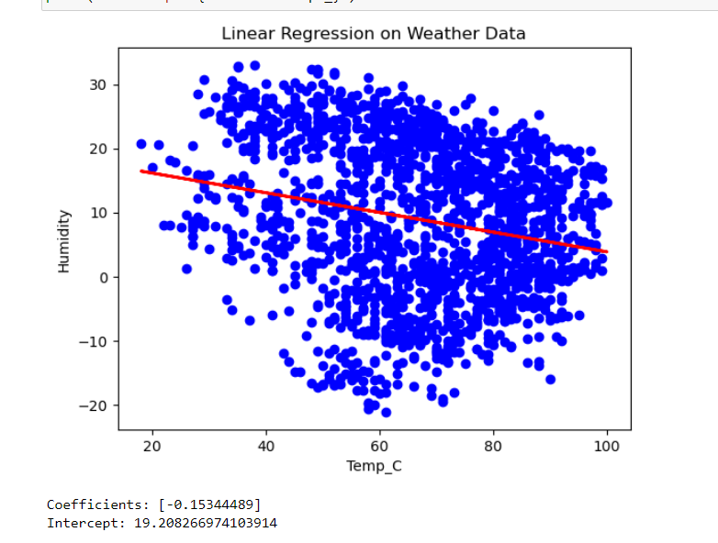
Linear Regression-

Slide 10
Data Visualization
Data visualization is the graphical representation of data to help people understand, interpret, and draw insights from the information. Visualizations use visual elements such as charts, graphs, maps, and diagrams to present data in a more accessible and meaningful way.
The goal of data visualization is to make complex information more understandable and accessible.

Slide 11
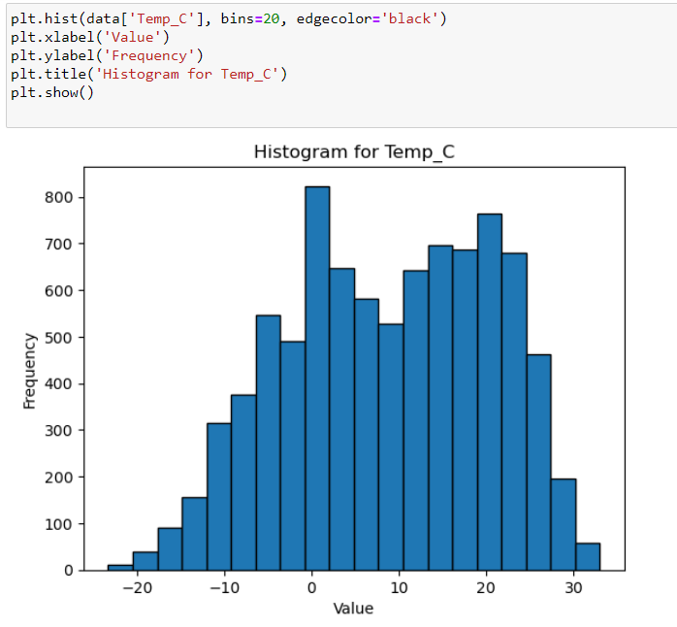
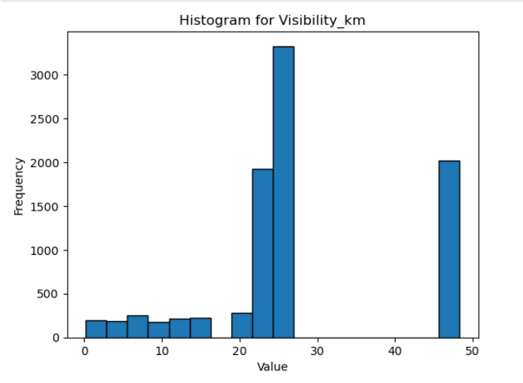
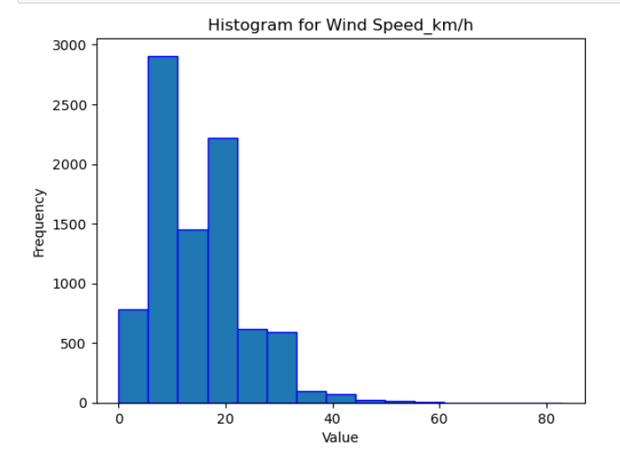
Histograms-

Slide 12
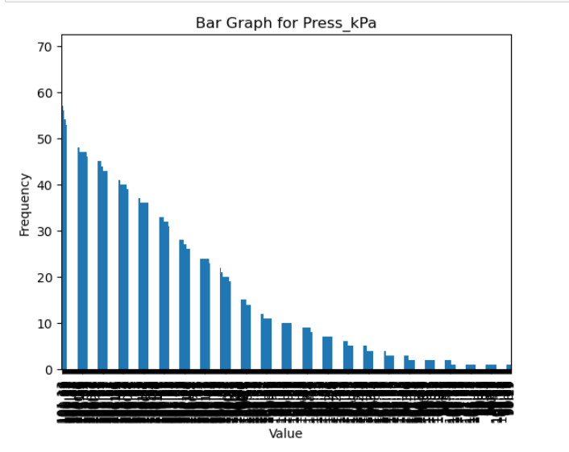
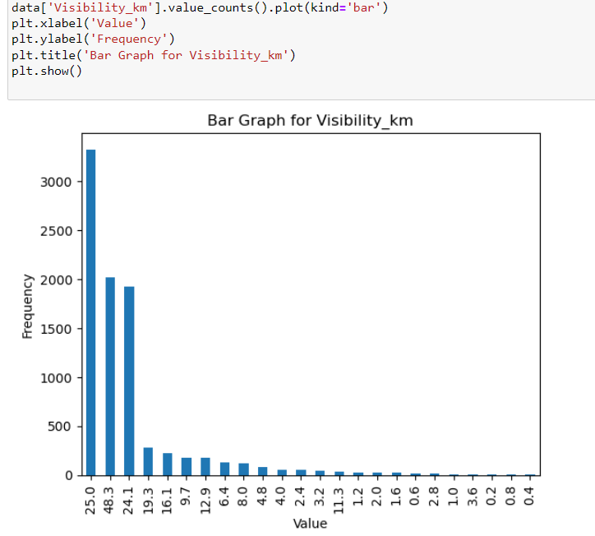
Bar graphs-

Slide 13
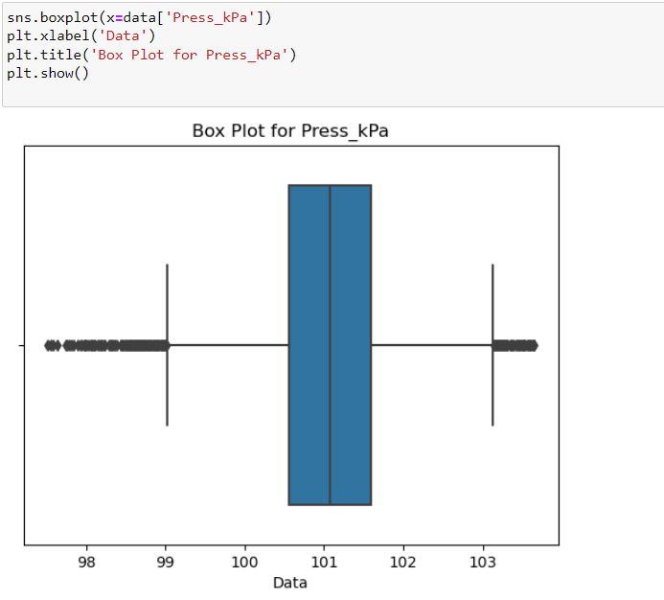
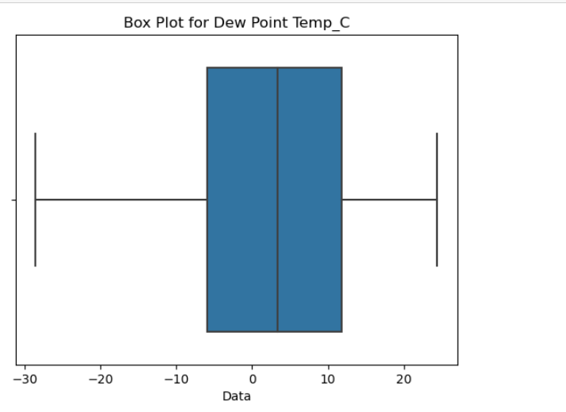
Box plot-

Slide 14
Exploratory Data Analysis (EDA)
EDA, or Exploratory Data Analysis, is a critical step in the data analysis process. It involves exploring and summarizing key characteristics of a dataset to gain a better understanding of its structure, patterns, and relationships. EDA plays a crucial role in the initial stages of data analysis.
EDA helps uncover relationships and patterns between different variables. This can include correlations between numerical features, trends in time series data, or associations between categorical variables.
It helps ensure that subsequent analyses are based on a solid understanding of the data, leading to more accurate and reliable results.

Slide 15
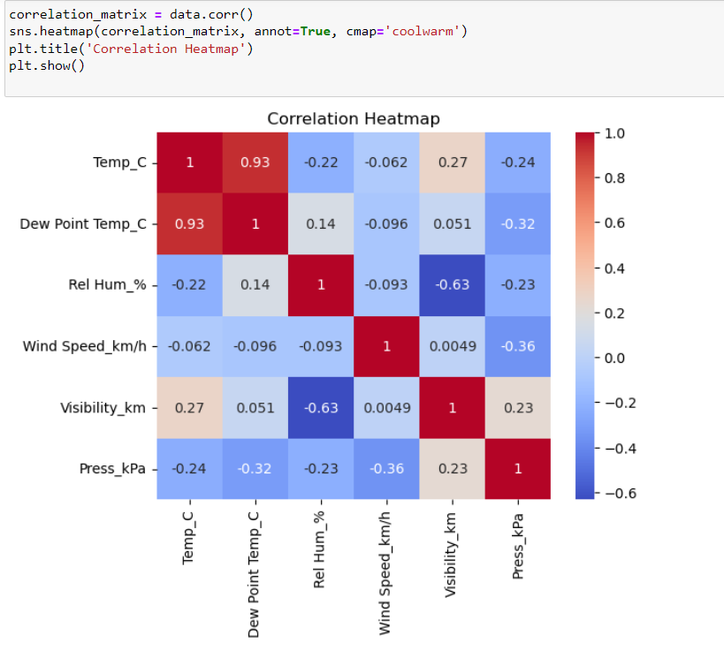
Correlation heatmap

Slide 16
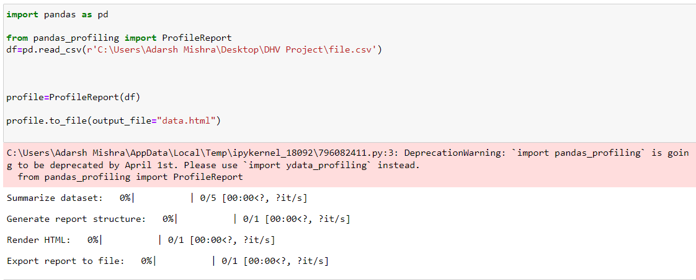
Final Results-
At last, using pandas-profiling library we can get overall analysis of data in a html file. And we will get final data analysis and visualization results.
file:///C:/Users/Adarsh%20Mishra/Desktop/DHV%20Project/dhv%20project%20data.html#overview

Slide 17
Conclusion-
In conclusion, our weather analysis provides valuable insights into the dynamic climate. The information presented here can be instrumental in making informed decisions related to [mention specific decision areas, e.g., resource management, disaster preparedness, or urban planning]. We hope that this analysis contributes to a better understanding of the local weather patterns and their implications for our community.“

Slide 18

Thank You !

